Slide 1
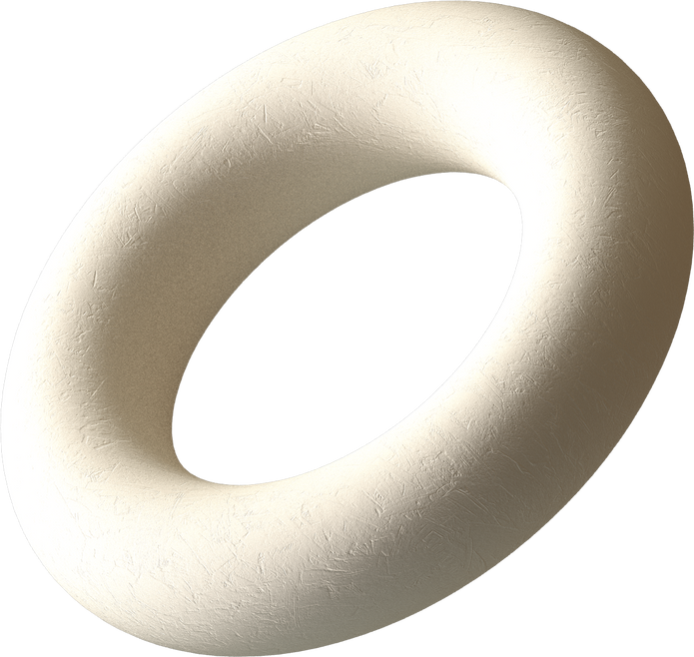
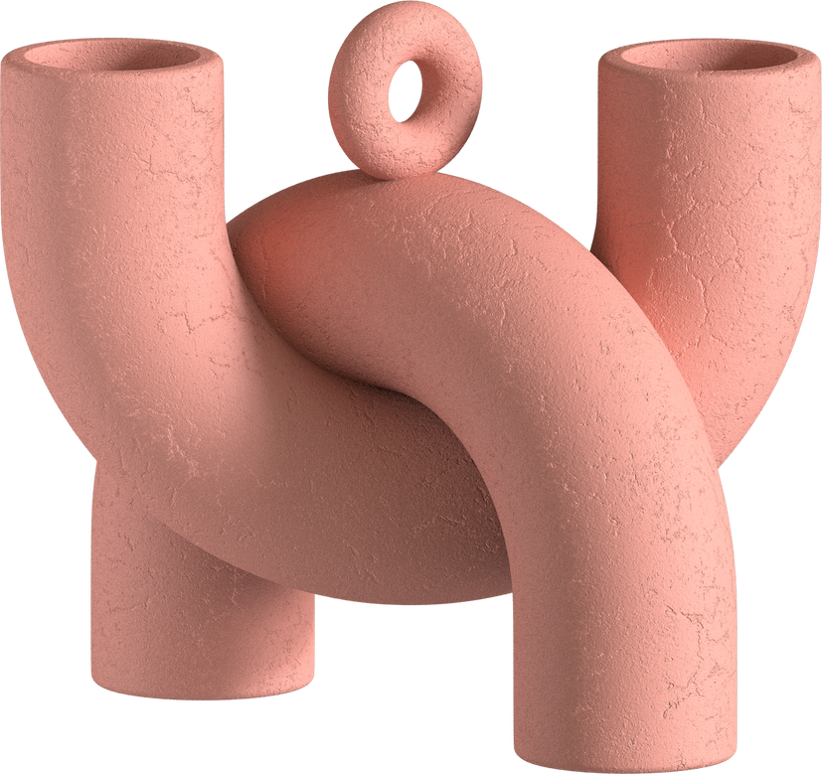
Quote
Generation
Lim Zhen Yang
DAAA/FT/2B/04

Slide 2
A brief history of NLP
1990s
Sepp Hochreiter and Jurgen Schmidhuber's introduction of Long Short-Term Memory (LSTM)
2000s
Introduced techniques like Latent Semantic Analysis and neural probabilistic language models
2010s
Google's development of the "Attention is all you need" paper
TechTarget. (2023). History of generative AI innovations spans 9 decades. Retrieved from https://www.techtarget.com/searchenterpriseai/tip/History-of-generative-AI-innovations-spans-9-decades
DataCamp. (2023). What Is Text Generation? [Blog post]. Retrieved from https://www.datacamp.com/blog/what-is-text-generation
OpenAI's GPT Series: Starting with GPT in 2018, followed by more advanced versions like GPT-3 and GPT-4

Slide 3



Limitations of Text Generation
LACK OF CONTEXTUAL UNDERSTANDING
OVERRELIANCE ON TRAINING DATA
DIFFICULTY IN HANDLING RARE OR UNSEEN SCENARIOS
They generate text based on patterns in the training data without truly understanding the meaning or intent behind the words.
If the training data is limited, or biased, the generated text may be biased, lack diversity, or exhibit other shortcomings
Text generation models may struggle when faced with uncommon or rare scenarios

Slide 4
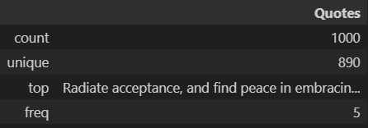
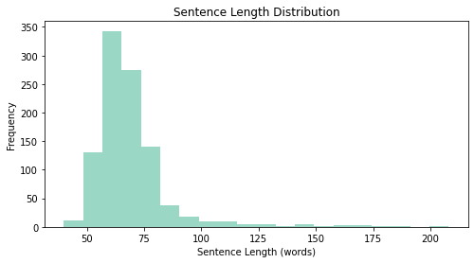
There are 1000 quotes
There are some duplicated quotes
EDA
exploratory data analysis
Number of quotes: 1000 Average quote length: 68.94 words

Slide 5
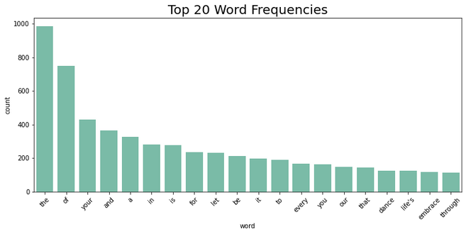
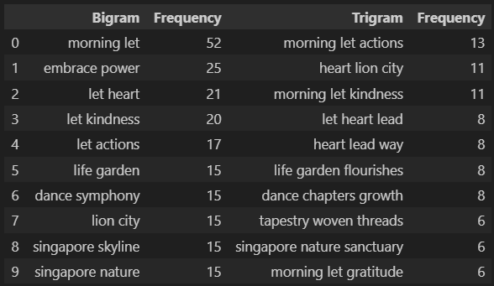
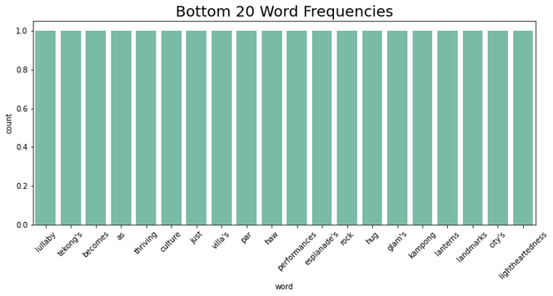
The distribution of word and phrase frequencies follows common linguistic patterns e.g.
EDA
exploratory data analysis
The least common words occur only once in the whole dataset.
The data seems to frequently include references to locations or themes consistent with Singapore

Slide 6
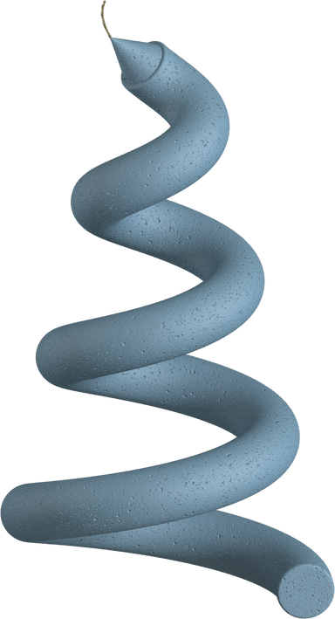
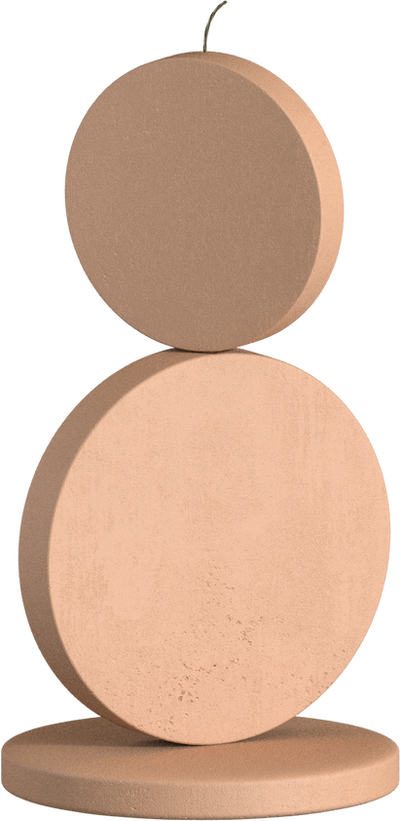
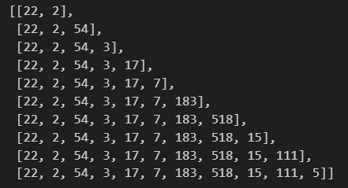
Data Preparation
Keeping punctuations
Adding a space before all punctuations to tokenize properly
Generating sequences by splitting quotes incrementally by rows

Slide 7
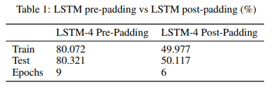
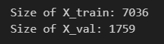
Data Preparation
Pre-padding tends to be more effective
Splitting data into train and validation sets to check for overfitting during training

Slide 8
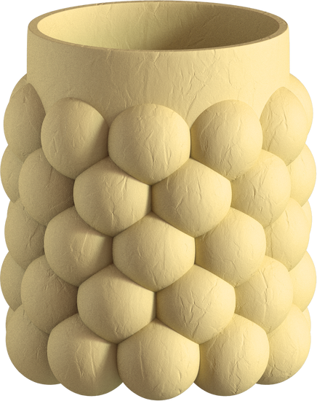

Data Augmentation
This process involves using NLTK's part-of-speech tagging to figure out the role of each word. Then, it transforms these tags into a format that works well with WordNet. Finally, it selects synonyms considering the word's specific part of speech, ensuring that the sentence remains grammatically correct.

Slide 9
Split by Character
Given our smaller dataset, character prediction may be an easier task, as there are at most 26 outputs excluding punctuation.
However it greatly limits the length of sentences that can be generated

Slide 10
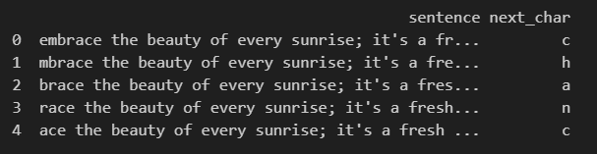
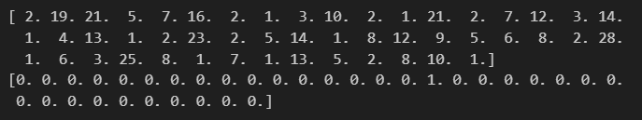
Split by Character
Sliding window method
Tokenize each character, then encode every sentence by character

Slide 11
RELEVANCE
Evaluation Metrics
Is the content on-topic?
COHERENCE AND FLOW
Does the text have a logical flow
GRAMMAR AND SPELLING
Human Analysis
Are there any grammatical errors
CONSISTENCY
Are the outputs generated consistent
ORIGINALITY
Is the output copied from training data?
CLARITY
Are there any confusing quotes?

Slide 12
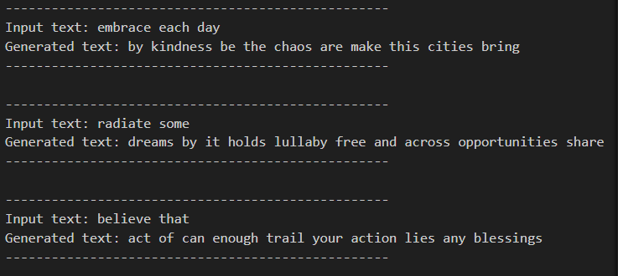
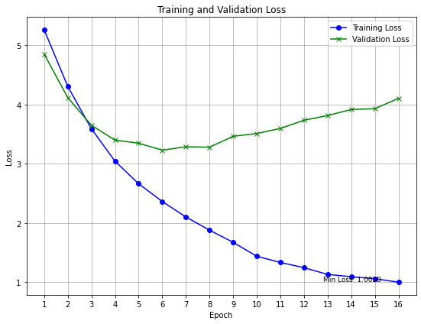
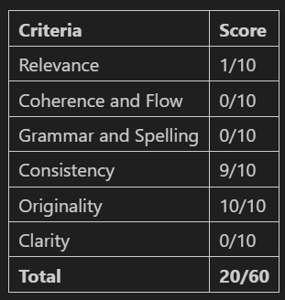
Base Model
SimpleRNN

Slide 13
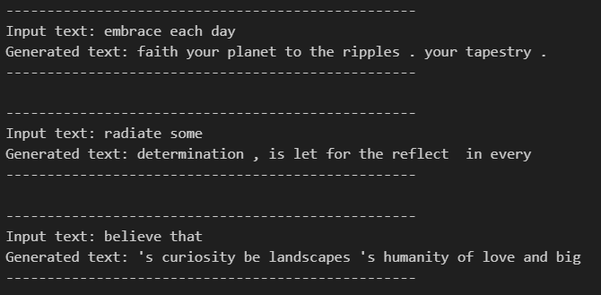
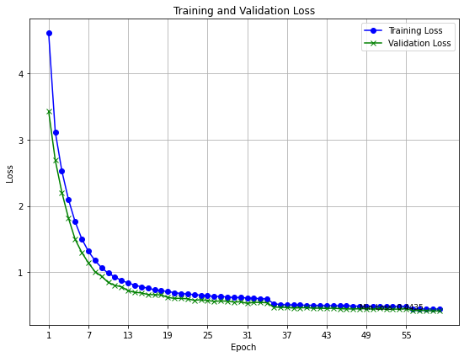
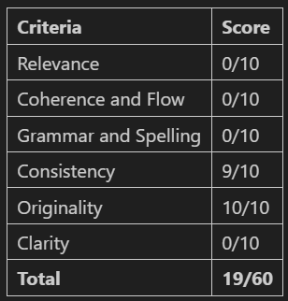
Base Model (Augmented)
SimpleRNN

Slide 14
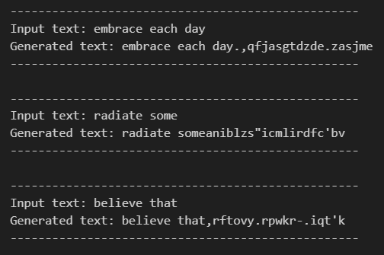
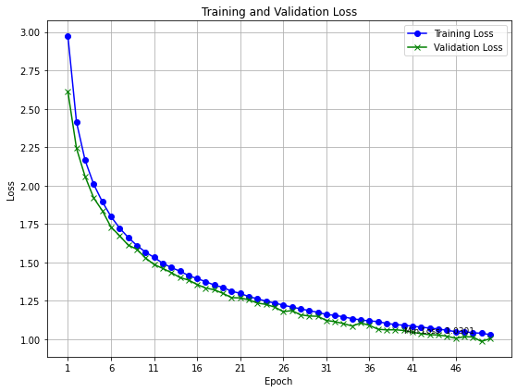
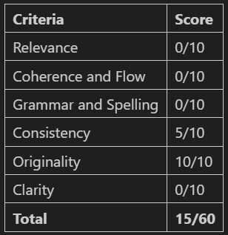
Base Model (Character)
SimpleRNN

Slide 15
Comparing LSTM to GRU
Aspect | LSTM | GRU
Architecture | Three gate layers | Two gate layers
Computational Complexity | More computationally intensive | Less computationally intensive
Parameter Size | Typically has more parameters | Fewer parameters
Capturing Long-Term Dependencies | Effective at capturing long-term dependencies | Can capture dependencies, slightly less effective with very long sequences
Training Speed | Slower convergence during training | Converges faster during training
Use Cases | Preferred for complex, long-range dependencies (e.g., NLP, speech recognition) | Suitable for computational efficiency or shorter-term dependencies

Slide 16
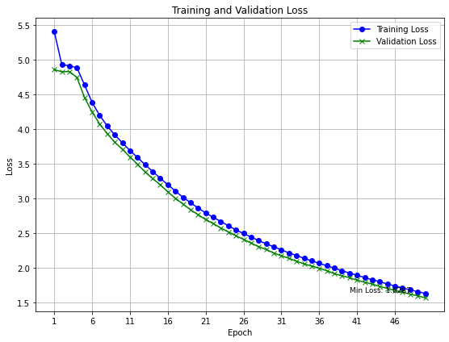
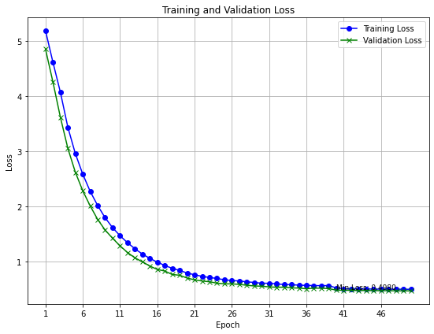
LSTM Model
GRU Model
2 Layer LSTM
2 Layer GRU

Slide 17
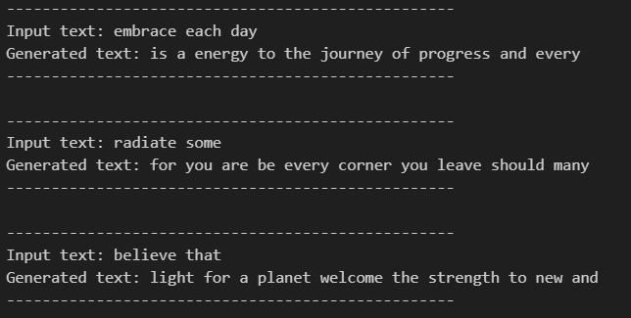
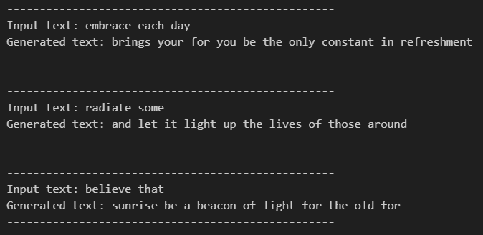
LSTM Model
GRU Model
2 Layer LSTM
2 Layer GRU

Slide 18
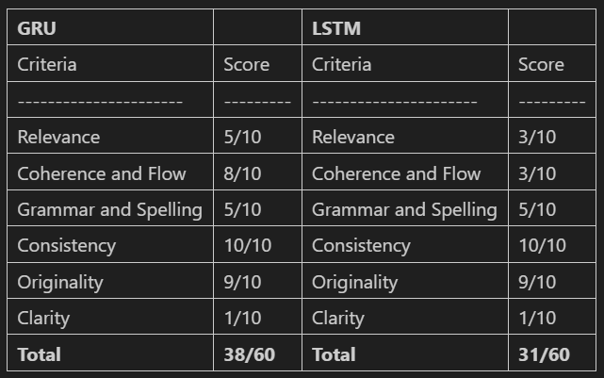
Comparing LSTM to GRU
Comparison

Slide 19
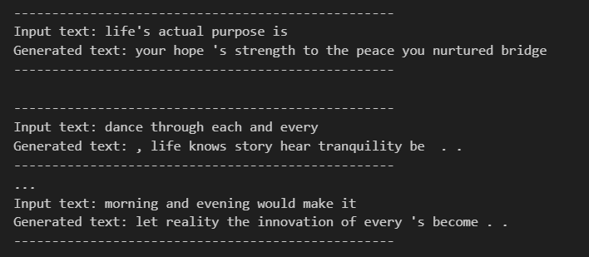
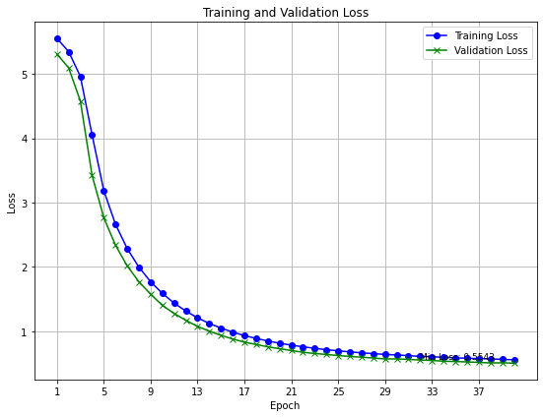
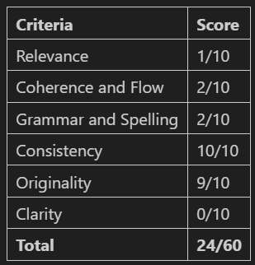
GRU Model (Augmented)
2 Layer GRU

Slide 20
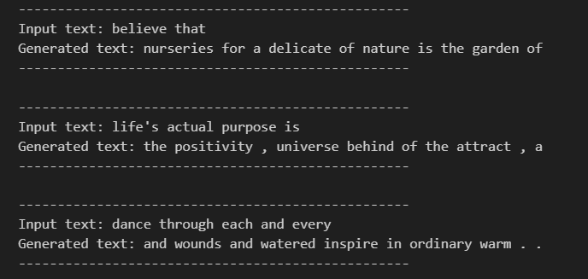
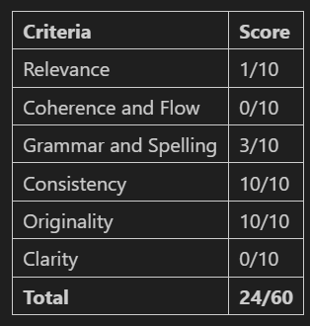
Bi-GRU Model (Bidirectional)
2 Layer GRU

Slide 21


Temperature
It is a hyperparameter that can be used to control the randomness and creativity of the generated text in a generative language model.
Higher temperature = more random and creative
Low temperature = less random and standardized

Slide 22
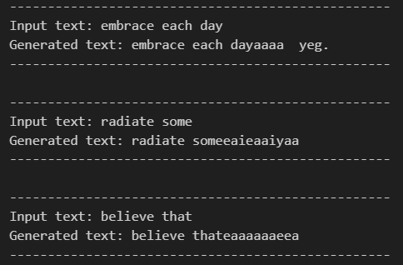
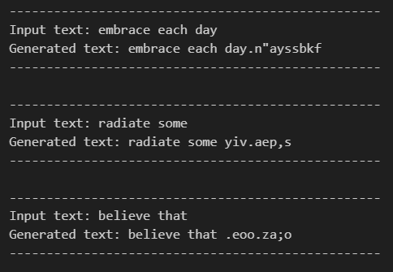
GRU Model (Character)
Temperature = 1.0
Temperature = 3.0

Slide 23

Transformers
Designed for various natural language processing tasks
It relies on a self-attention mechanism to capture relationships between different words or elements in a sequence
Allows it to process input data in parallel and at different positions
Highly efficient for long sequences, and getting great performance.

Slide 24
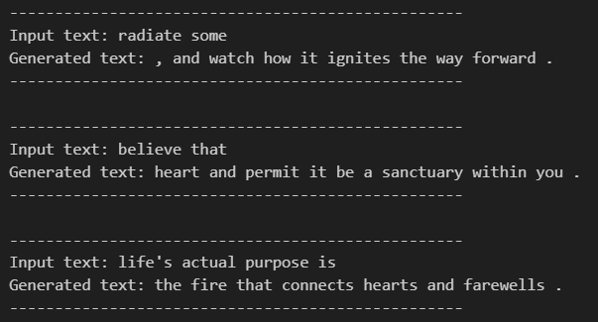
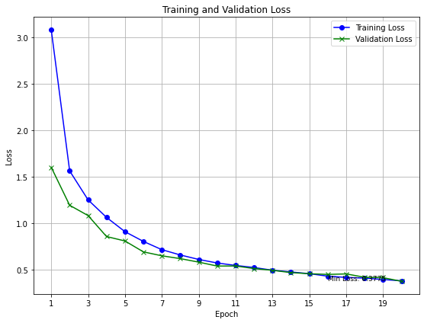
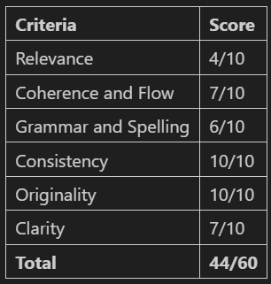
Transformer
Trained on augmented data

Slide 25
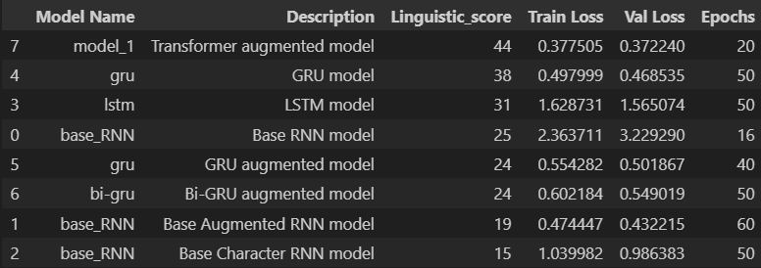
Model Selection
By linguistic score

Slide 26


Model Improvement
Keras Tuner
10 Trials
10 epochs each
Embedding size
Number of attention heads
Feed forward dimension

Slide 27
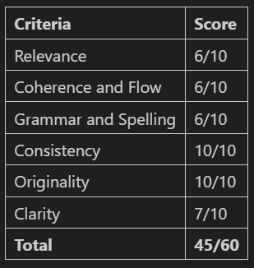
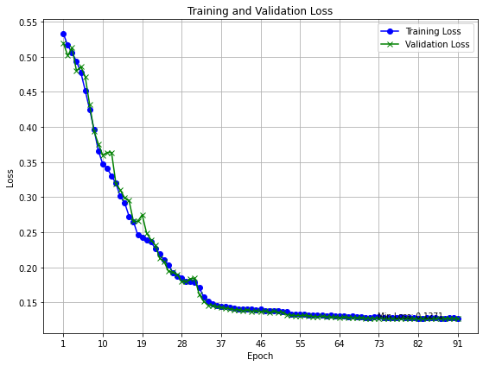
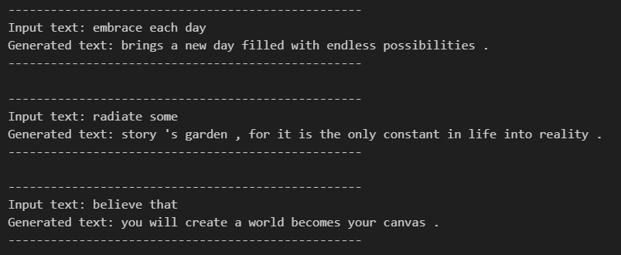
Final Model
Rebuilt the best model with 100 epochs

Slide 28
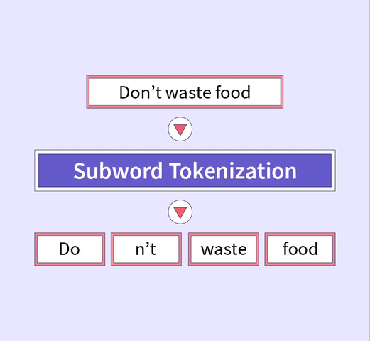
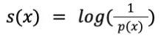
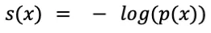
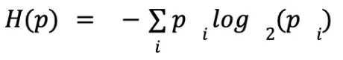
Futher Improvements
Subword tokenization
Perplexity

Slide 29
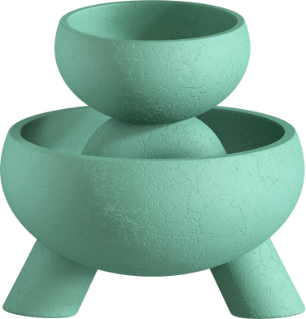
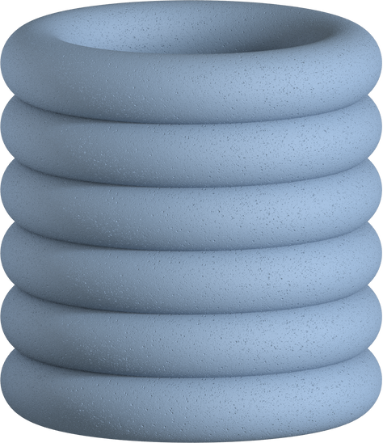
THANK YOU

